Slide 1
Welcome to LGBTIQA+ Ally Training
Developed by the Safe Zone Project
www.TheSafeZoneProject.com
Presented by
The Montana Family Center
www.mtfamilycenter.org

Slide 2
Introductions
Presenters today are:
Please introduce yourself with:
Your Preferred Name (how you want to be addressed in this group)
Your Preferred Pronouns
Two Learnings That You’d Like to Leave This Training With

Slide 3
GROUP NORMS
Be Smarter than Your Phone
Questions, Questions, Questions
Vegas Rule
LOL
Share the Airtime
Reserve the Right to Change Your Mind

Slide 4
First Impressions of LGBTQ People
When was the first time you can remember learning that some people are lesbian, gay, bisexual, or queer?
Where did most of the influence of your initial impressions/understanding of lesbian, gay, bisexual, and queer people come from? (e.g., family, friends, television, books, news, church)
When was the first time you can remember learning that some people are transgender?
Where did most of the influence of your initial impressions/understanding of transgender people come from? (e.g., family, friends, television, books, news, church)
How have your impressions/understanding of LGBTQ (lesbian, gay, bisexual, transgender, and queer/questioning) people changed or evolved throughout your life.

Slide 5
LGBTQ-INCLUSIVE LANGUAGE DOs and DON’Ts
Avoid Saying Say Instead Why? Example
“Hemaphrodite” | “Intersex” | Hermaphrodite id a stigmatizing, word with a negative medical history. | “What are the best practices for the medical care of intersex infants?”
“Homosexual” | “Gay” | “Homosexual” often connotes a medical diagnosis, or a discomfort with gay/lesbian people | “We want to do a better job of bring inclusive of our gay employees.”
“born female” or “Born Male” | “Assigned female/male at birth” | “Assigned” language accurately depicts the situation of what happens at birth. | “Max was assigned female at birth, then he transitioned in high school”
“A gay” or “a transgender” | “A gay/transgender person” | Gay and transgender are adjectives that describe a person/group | “We had a transgenders athlete in our league this year”
”Transgender people and normal people” | “transgender people and cisgender people” | Saying “normal” implies “abnormal” which is a stigmatizing way to refer to a person. | “This group is open to both transgender and cisgender people”

Slide 6
LGBTQ-INCLUSIVE LANGUAGE DOs and DON’Ts
Avoid Saying Say Instead Why? Example
“Both genders” or “opposite sexes” | “All Genders” | “Both” implies there are only two; “opposite” reinforces antagonism amongst genders | “Video games are’t just a boy thing—kids of all genders play them.”
“Ladies and gendtlemen” | “Everyone,” “Folks,” “honored guests.” etc | Moving away from binary language is more inclusive of prople of all genders | “Good morning, everyone, next stop Piccadilly Station”
“Mailman,” “fireman,” “policeman.” etc | “Mail clerk,” “firefighter,” “police officer,” etc | People of all genders do these jobs | “I actually saw a firefighter rescue a cat from a tree.”
“It” when referring to someone (e.g., when pronouns are un known) | “They” | “It” is for referring to things, not people. | “”You know, I am not sure how they identify.” ”

Slide 7
LGBTQ-INCLUSIVE LANGUAGE DOs and DON’Ts
AVOID SAYING... | SAY INSTEAD... | WHY? | EXAMPLE
"Hermaphrodite" | "Intersex" | Hermaphrodite is a stigmatizing, inaccurate word with a negative medical history. | "What are the best practices for the medical care of intersex infants?"
"Homosexual" | "Gay" | "Homosexual" often connotes a medical diagnosis, or a discomfort with gay/lesbian people. | "We want to do a better job of being inclusive of our gay employees."
"Born female" or "Born male" | "Assigned female/male at birth" | "Assigned" language accurately depicts the situation of what happens at birth | "Max was assigned female at birth, then he transitioned in high school."
"Female-bodied" or "Male-bodied" |  | "-bodied" language is often interpreted as a pressure to medically transition, or invalidation of one's gender identity
"A gay" or "a transgender" | "A gay/transgender person" | Gay and transgender are adjectives that describe a person/group | "We had a transgender athlete in our league this year. "

Slide 8
LGBTQ-INCLUSIVE LANGUAGE DOs and DON’Ts
AVOID SAYING... | SAY INSTEAD... | WHY? | EXAMPLE
Transgender people and normal people" | "Transgender people and cisgender people" | Saying "normal" implies "abnormal," which is a stigmatizing way to refer to a person. | "This group is open to both transgender and cisgender people."
"Both genders" or "Opposite sexes" | "All genders" | "Both" implies there are only two; "Opposite" reinforces antagonism amongst genders | "Video games aren't just a boy thing -- kids of all genders play them."
"Ladies and gentlemen" | "Everyone," "Folks," "Honored guests," etc | Moving away from binary language is more inclusive of people of all genders | "Good morning everyone, next stop Picadilly Station."
"Mailman," "fireman," "policeman," etc. | "Mail clerk," "Firefighter," "Police officer," etc. | People of all genders do these jobs | "I actually saw a firefighter rescue a cat from a tree."
"It" when referring to someone (e.g., when pronouns are unknown) | "They" | "It" is for referring to things, not people. | "You know, I am not sure how they identify."

Slide 9
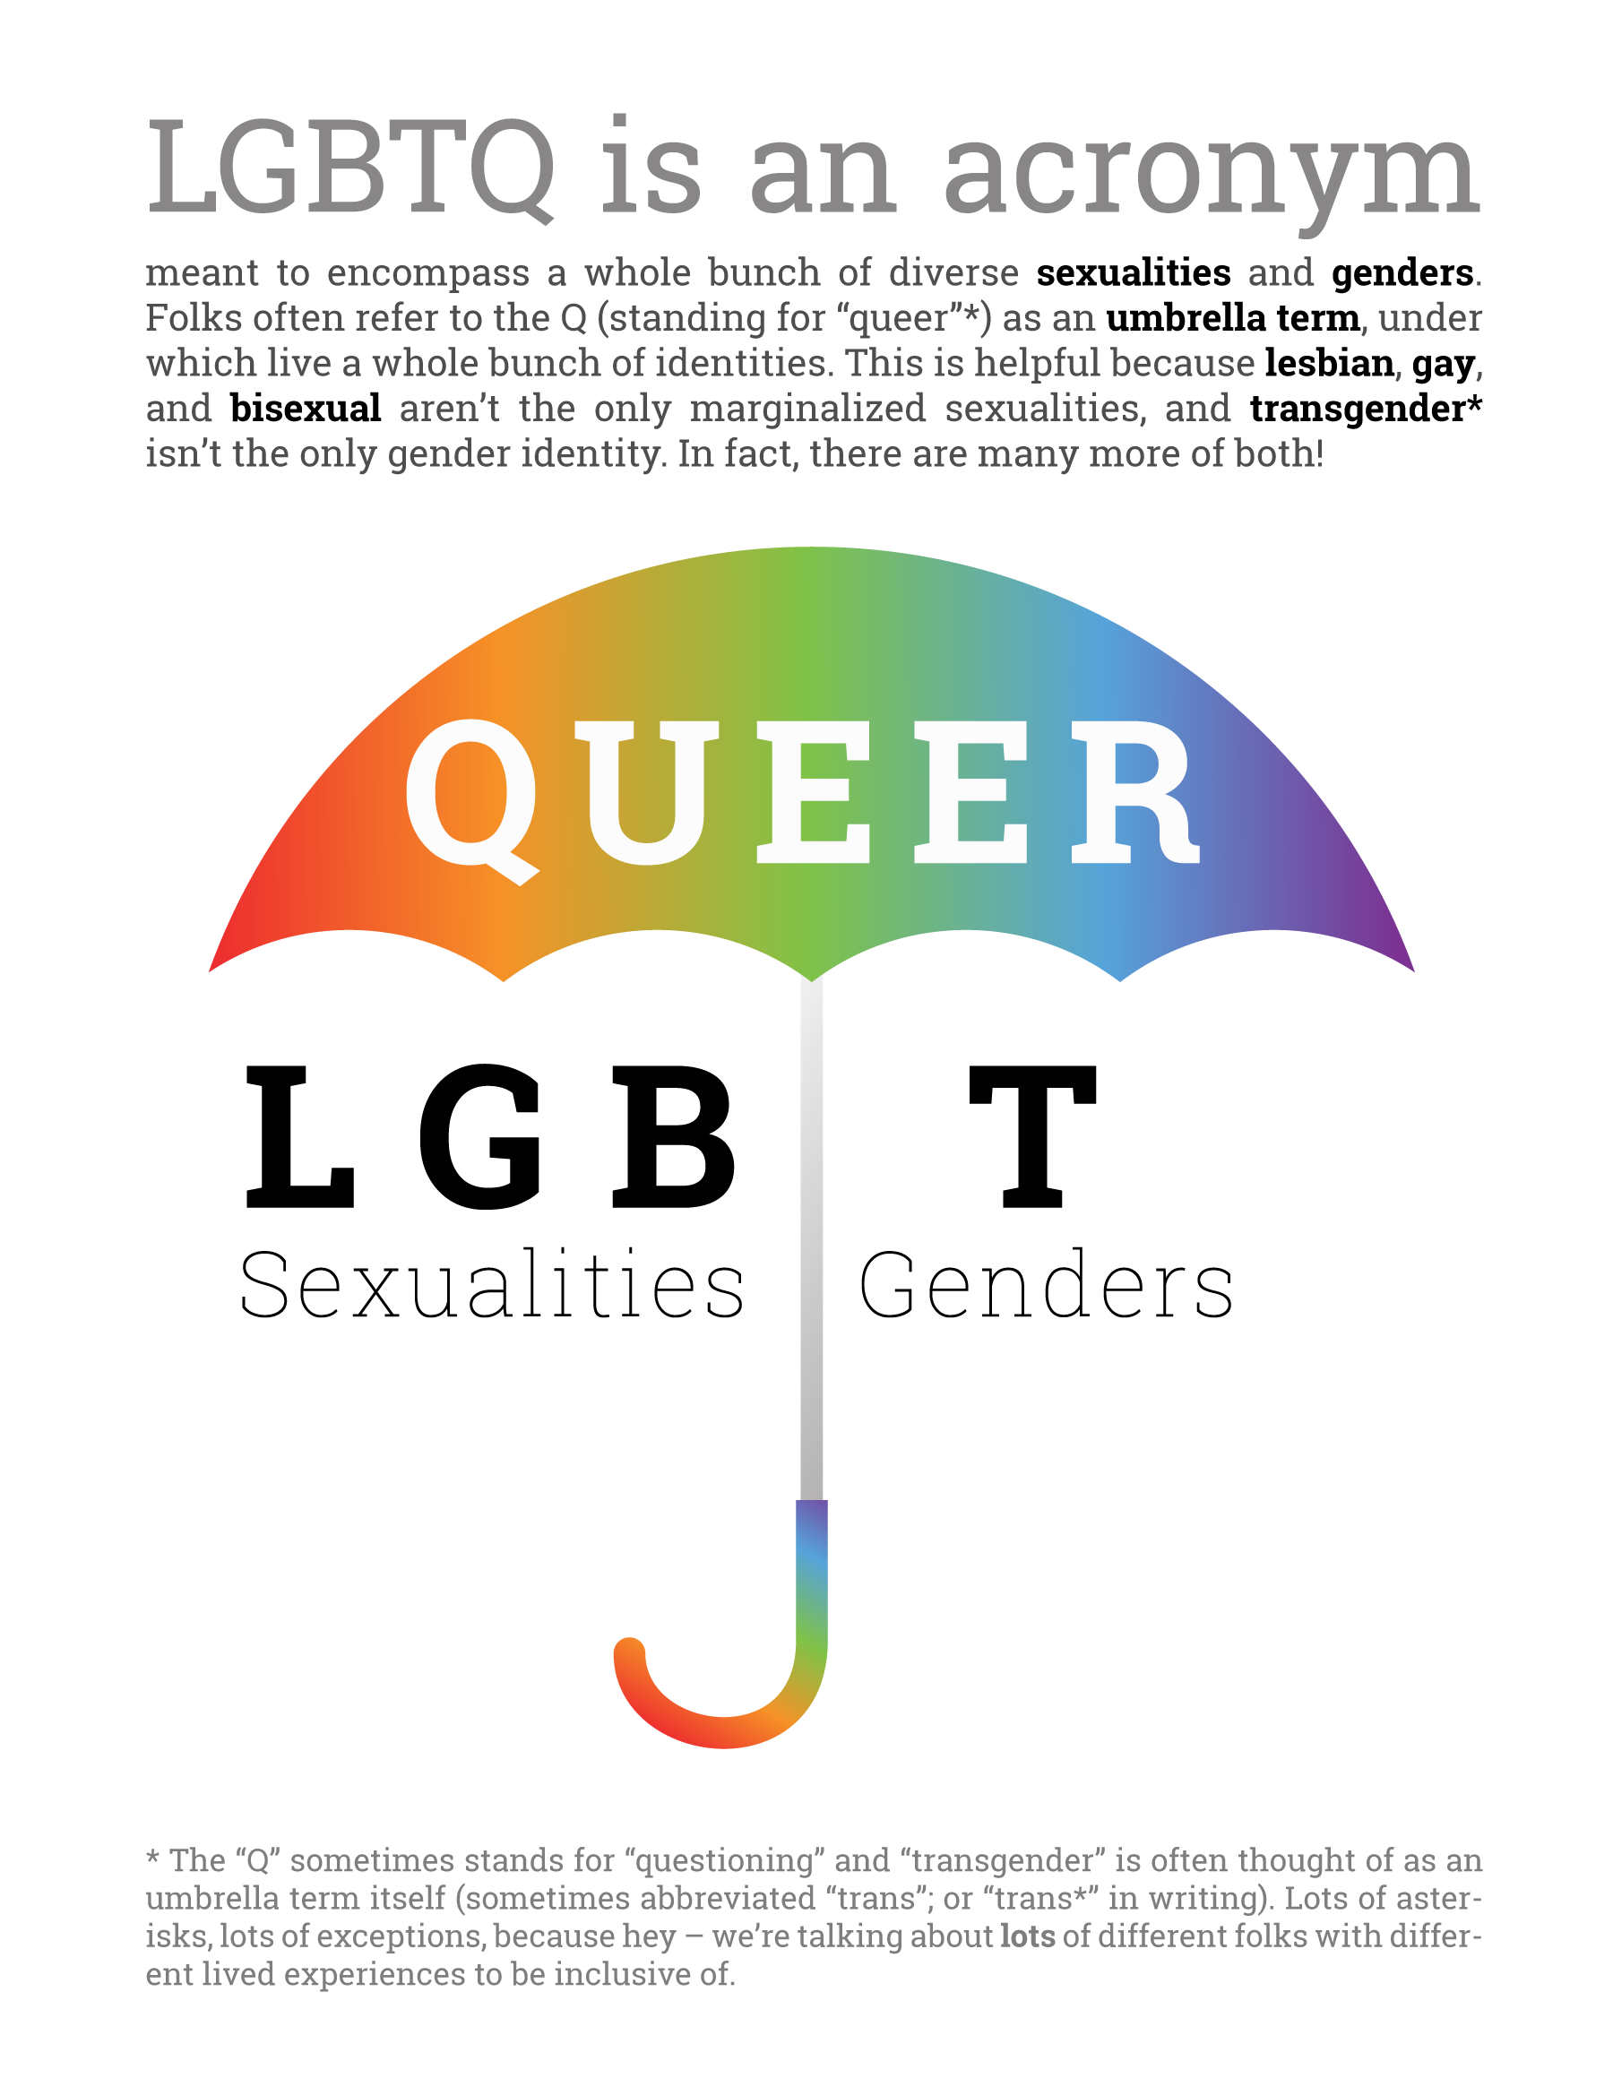

Slide 10
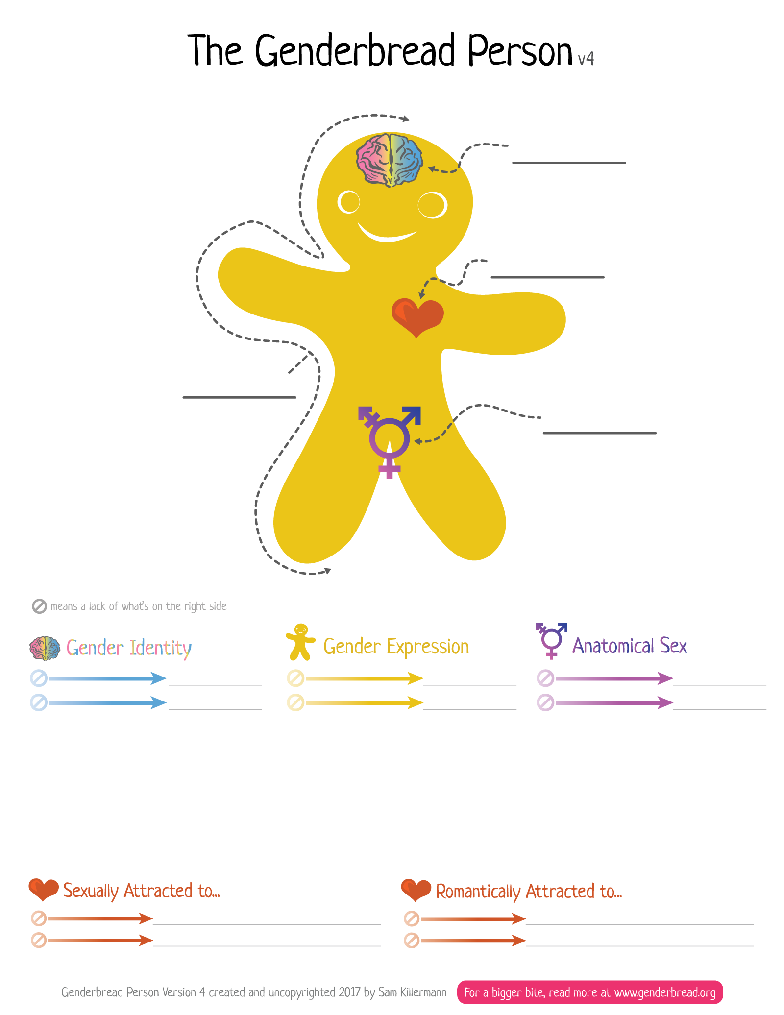
Identity
Attraction
Expression
Sex
Woman-ness
Femininity
Female-ness
Man-ness
Masculinity
Male-ness
Identity ≠ Expression ≠ Sex
Gender ≠ Sexual Orientation
Women a/o Feminine
Women a/o Feminine
Men a/o Masculine
Men a/o Masculine

